Slide 1
Authentication & Authorization

Slide 2
Authentication
is the act of confirming the truth of an attribute of a datum or entity - wiki
Establishing identity
Prevents impersonation
Determining Authenticity

Slide 3
Examples
Driver's License
Passport
Fingerprint
Retina pattern
DNA
Shared secret?
Combination?

Slide 4
Authorization
Establishing permission to do something specific

Slide 5
Examples
Movie ticket
Password
RPI ID (as a keycard)
Access Control List (ACL)

Slide 6
Authentication vs Authorization
What is the difference?

Slide 7
Authentication vs Authorization
If you need to know whether someone is authentic, they need to authenticate.
If you need to know whether someone has the authority to do something, they need to be authorized.

Slide 8
On the Web
Users authenticate to a system
Username & Password are checked
User information stored in a session
Server checks for authorization to site or to perform specific tasks
Additional database queries/actions
Authorizations should not be cached in the session
What if we wanted to revoke a user’s access immediately?

Slide 9
<code> login_insecure.php
Create a users table that stores a username and a plaintext password, and insert a number of test users
Create a new PHP page
If no user is logged in, present them with a login form (for the password's input element, the type should be password)
If a user is logged in, print their username, user ID, and a logout button that destroys their session

Slide 10
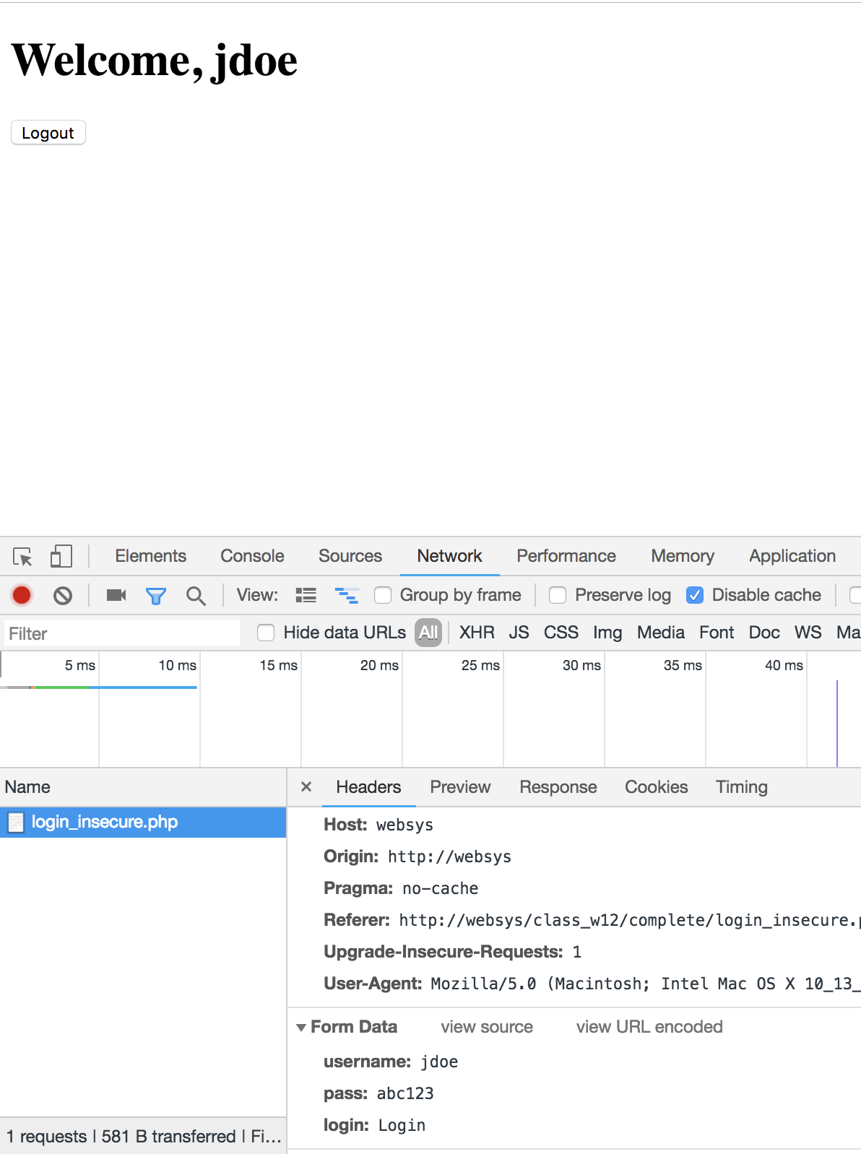

Slide 11
<note> some practical issues
Authentication – What if someone gets a hold of the database?
All of the passwords are plain text!
Users often use the same password on multiple sites...
Authorization – This is fine for now, but what if different users need to be able to do different things?

Slide 12
Better Password Storage
Hash functions
One-way transformations
Can get the hash from plaintext
Can’t get the plaintext from the hash
User creates an account
Password is hashed and stored
User attempts to login, hashes are checked
If match – authenticated
If not – show error, try again
Do NOT tell them what exactly, was wrong

Slide 13
Better Password Storage
Never store the plaintext password
Use cryptographic hashes
To implement the hash
Call the hash function on the plaintext password when storing it
Call the hash function on the password when reading it from input
If the two hashes match – we are authenticated (assuming no collisions)

Slide 14
Better Password Storage
Not all hash functions are secure
Md5() – vulnerable
Sha1() – outdated
hash() – sha3, sha256, sha512, etc are better
None of this is useful without good passwords to start with
Requires sufficiently long passwords – min 8 chars
Don’t set a limit on the max number of characters

Slide 15
Rainbow Tables
Attackers can compute hashes ahead of time, and store the plaintext with the hash in a Rainbow Table
Size is impractically large as more/longer passwords stored
Rainbow tables store chains of hashes to help reduce the size of the table
If the hash is found in the table, the plaintext can be looked up

Slide 16
Password Salting
Salt
a random string added to the plaintext before hashing
Salt will be needed for authentication so it needs to be stored
Do not
Reuse
Use the username
Use short salts
Generally, should be as long as the resulting password hash itself (sha256=32bytes➔salt=32bytes)

Slide 17
Password Salting
What stops crackers from building another rainbow table using the global salt?
Give each user their unique salt when
the password is generated
the password changes
$salt = hash(‘sha256’,uniqid(mt_rand(), true));
Doesn't matter if the salt is stored with the hash
They have to create rainbow tables for every user
This specific type of attack is now infeasible – better off just brute forcing each…

Slide 18
Brute Force?
Can still guess all possibilities
Not difficult to automate (bots)
Solutions?
Prevent failed login attempts
Don’t restrict characters or length
Set an appropriate minimum (8?)

Slide 19
<aside> HTTPS
HTTP is not encrypted – request body is sent as plaintext
So passwords can be intercepted – even if they are hidden on the display
Use HTTPS to prevent this
Secure connection
Not covered this semester
If interested, check out ‘self-signed’ certificates

Slide 20
<code> register.php login_secure.php
Lets add a ‘salt’ field to our users table
make new table named users_secure
Create a new page register.php which contains a form to allow us to add users to the database
Generate a unique salt for each user entered
Hash the password using the salt prior to storing it
Modify the login page to authenticate using the new salted hash

Slide 21
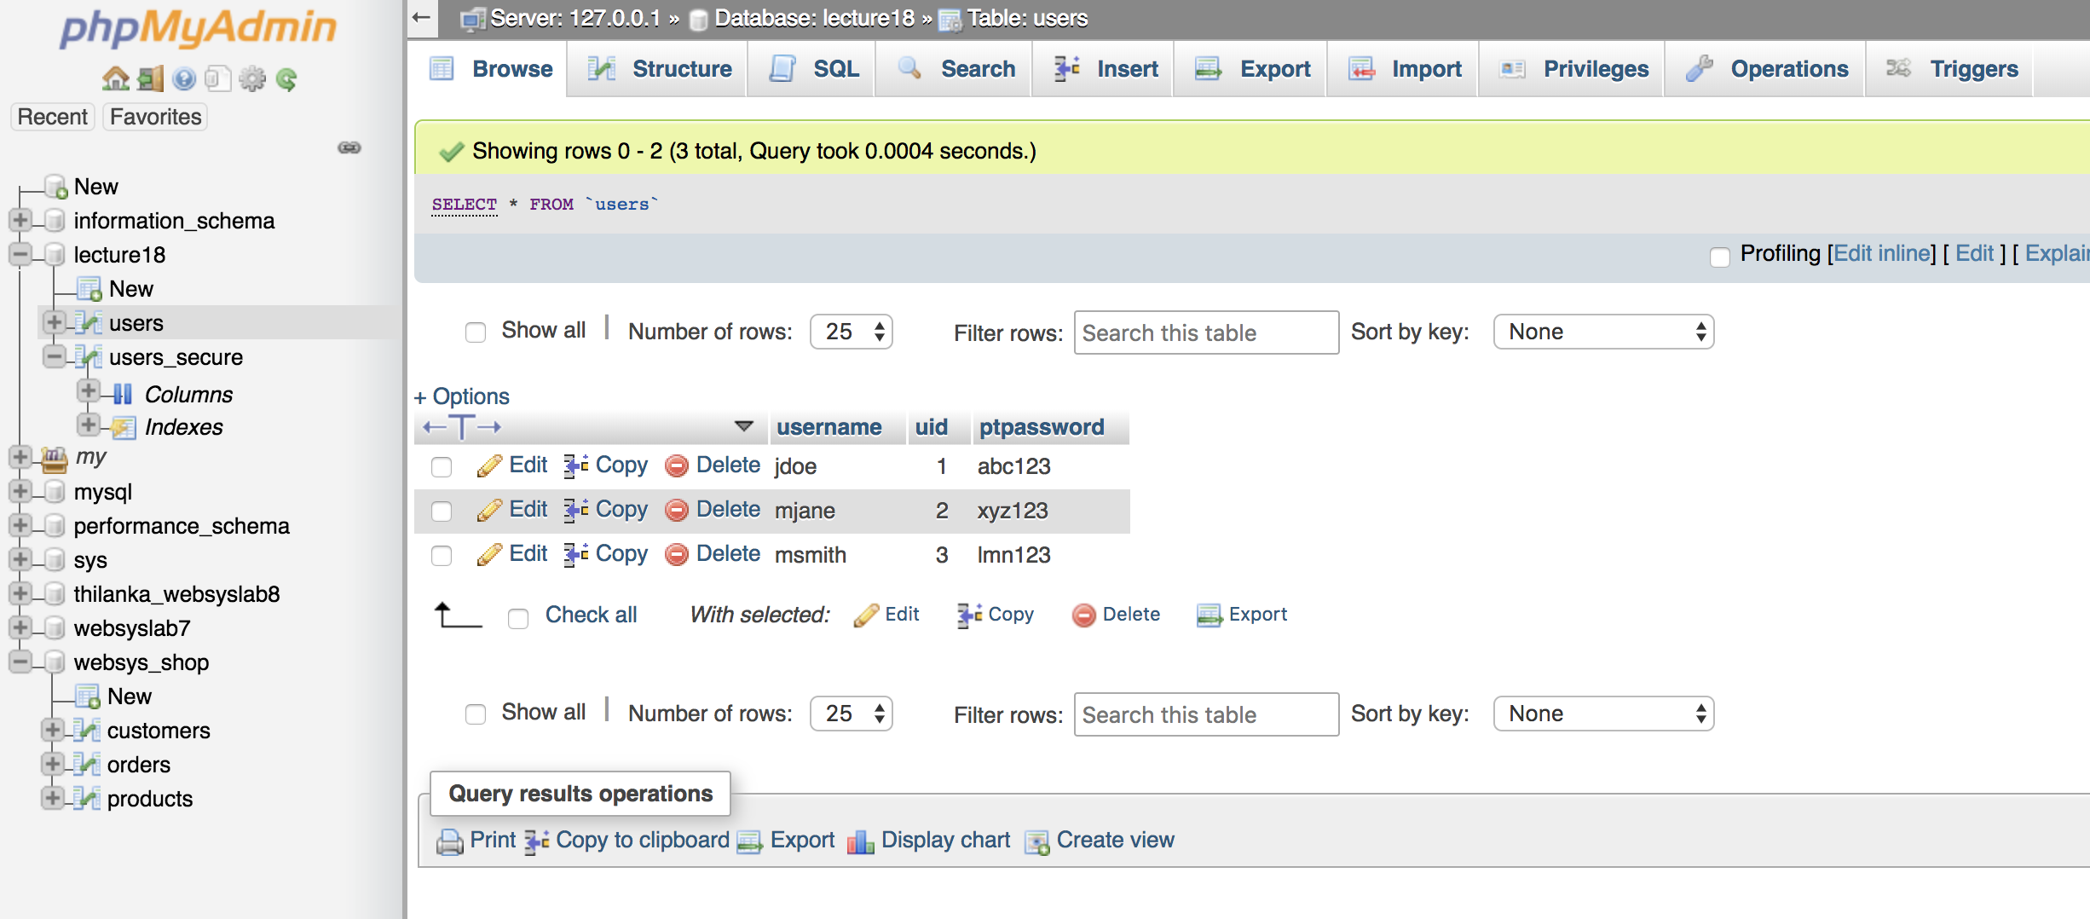
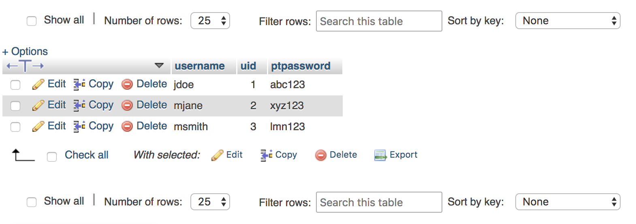
You can See the
Passwords
Unsecure Table

Slide 22
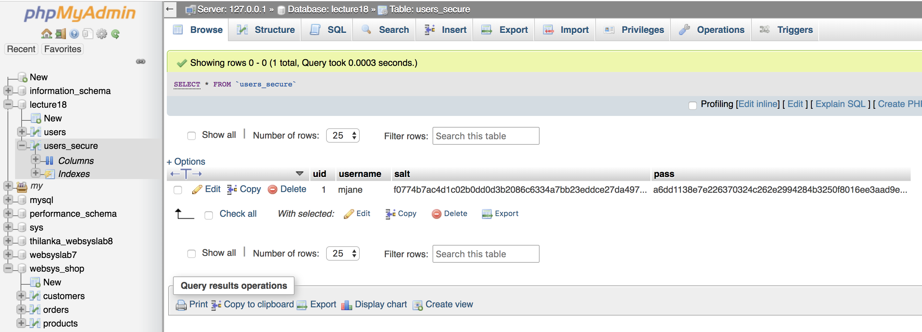
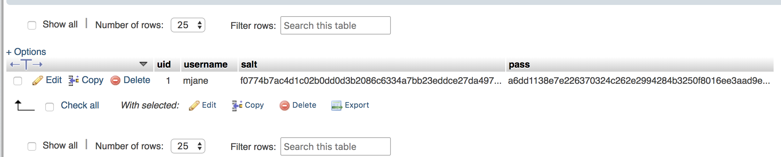
Secure Users Table

Slide 23
</authentication> Authorization
What if different users need to do different things on the site?
- Example : LMS
Need to support the notion of user permissions or roles

Slide 24
Permission-based Authorization
Grant permission to users explicitly
Peter, Paul and Mary can contribute
Eric is the moderator
Ringo and George publish
Etc…

Slide 25
Permission-based Authorization implementation
Lets say we have the following 2 database tables setup
Users : uid, username, password, salt
Permissions: pid, permname, description
Then we would need a new table to relate them
User_perms : uid, pid
Now we can put users into our permission file and check for authorization

Slide 26
Permission-based Authorization
Pros: Provides the most granularity
Cons: Can be difficult to administer when assigning permissions to individual users
Gets cumbersome

Slide 27
Role-based Authorization
Certain roles can do certain things – what these things are is hard-coded
Writers write – authors
Create, write, edit own …
Editors edit – write & edit
Create, write, edit own, edit others …
Same as writers plus more
Publishers publish
Create, write, edit own, edit others, delete, approve, etc
Same as writers + editors + more…
Etc…

Slide 28
Role-based Authorization Example
Support site (perhaps)
Roles: Admins, moderators, contributors, reviewers
Anyone can review
To comment you have to register
A moderator can review and approve posts
An admin can make announcements, bring site down, etc.

Slide 29
Role-based Authorization implementation
Lets say we have the following 2 database tables setup
Users : uid, username, password, salt
Roles : rid, rolename, description
Then we would need a new table to relate them
User_roles : uid, rid
Now we can put users into groups and then authorize based on role

Slide 30
Role-based Authorization
Pros: Good at breaking down certain types of users, new roles can be added easily
Cons: Loss of granularity, (can be) less flexible when adding new functionality, combines authentication (who you are) with authorization (what you can do)

Slide 31
Combining Roles and Permissions
I have a writer who needs to be able to moderate one specific topic on my support site. Doesn’t really fit into a role, but I want to maintain some order
So we can combine the methodologies
But be careful
Easy to deviate from the group role paradigm introducing more chaos
Notes:
Example

Slide 32
Combining Roles and Permissions
Check to see
If they have a role
What permissions the role has
What specific authority the person has
Our files now:
user(uid, uname, pass, salt)
permission(pid, permname, desc)
role(rid, rolename, desc)
user_roles(uid, rid)
role_permission(rid, pid)

Slide 33
Combining Roles and Permissions
Need to join necessary tables...
SELECT p.permname
FROM permission p
INNER JOIN role_permission rp ON p.pid = rp.pid
INNER JOIN user_roles ur ON ur.rid = rp.rid WHERE ur.uid = 1

Slide 34
Combining Roles and Permissions
Pros: More flexibility, allows for reuse of permission sets
Cons: More difficult to implement

Slide 35
<aside> Object Authority
What if each database (or object) maintained a table of who/what could authorize it?
Kind of like files in *NIX
Then:
No matter what authority group the user is in (Admin or *SECOFR)
No matter what specific permission the user has been granted (ie *READ, *WRITE)
If the object (customer_master) says rplotka, *EXCLUDE – I’m out
Not in the scope of this class

Slide 36
<code> login_secure_auth.php register_auth.php
Add a new column to your users table, "is_admin”
Make one of your users an admin when you're done
Modify your register page to redirect the user back to the login page if is_admin is false for that user
Use Header()
Be sure to call exit() after setting Location headers, so no other scripts interfere

Slide 37
</class>

